Slide 1
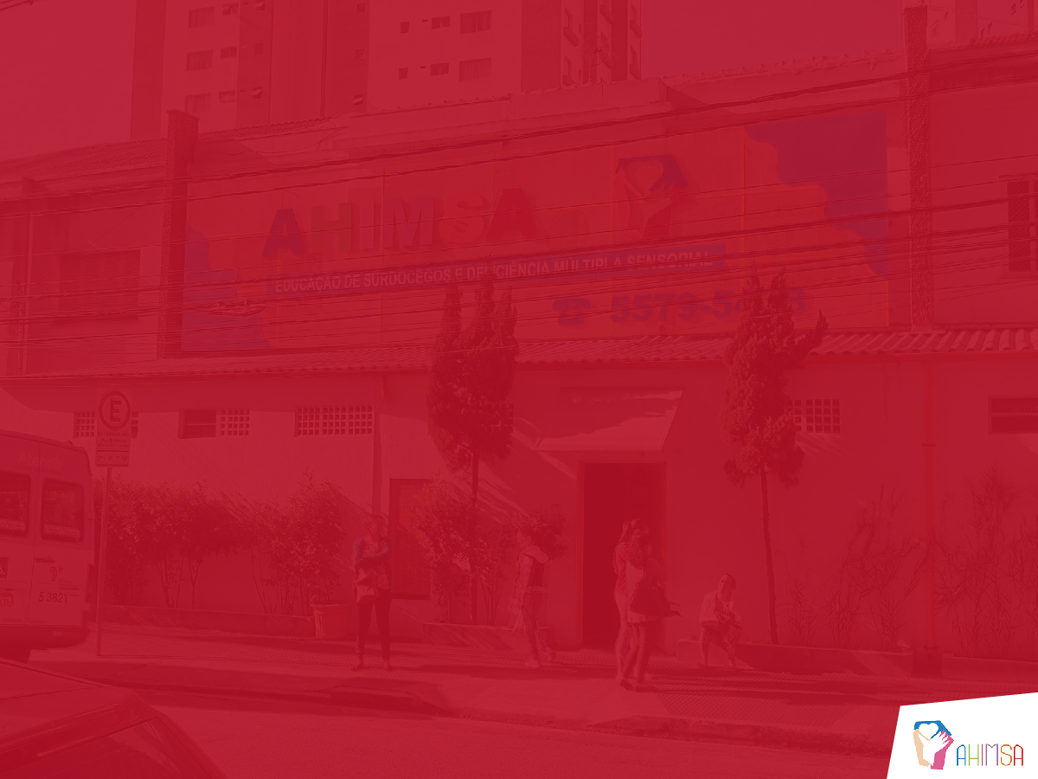
Notes:
Take a moment to think about all of the ways that I’m communicating with you in this moment. I’m speaking to you, but my message is so much more than just the words. You can see the expression on my face. You can hear the tone of my voice. You can see the gestures I’m using. All of these things collectively are helping you to understand my message and the feelings that I’m trying to evoke.
This experience of understanding a spoken message like the one you’re currently listening to becomes incredibly difficult when you are missing or have seriously difficulties seeing or hearing. As adults we can probably imagine being able to compensate somehow, but consider what this would be like as a young child.

Slide 2

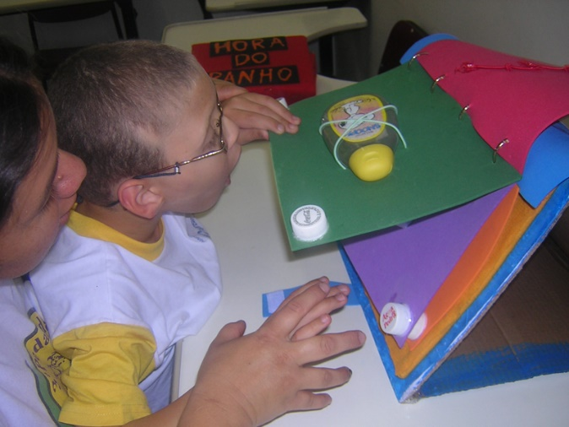

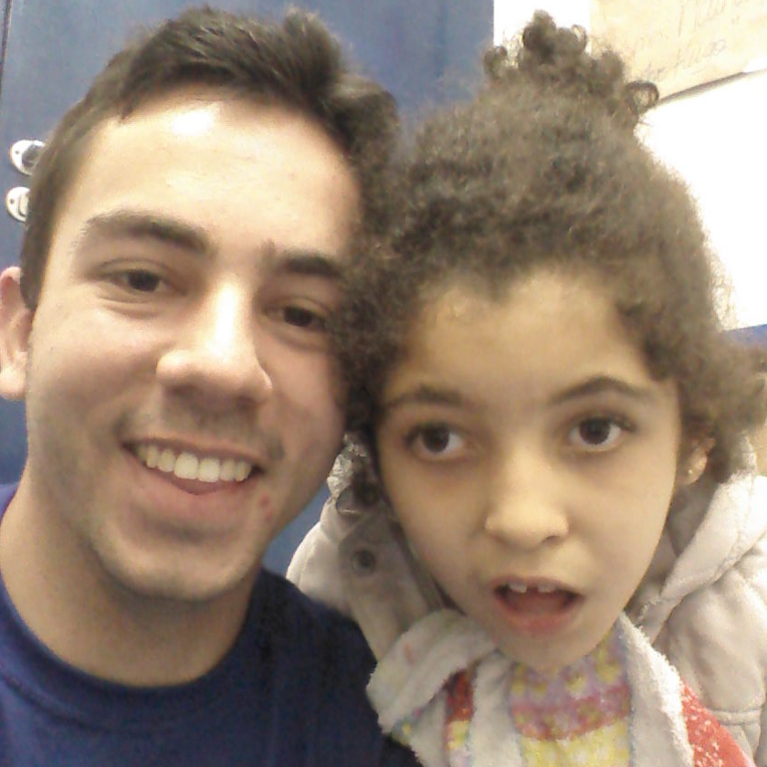
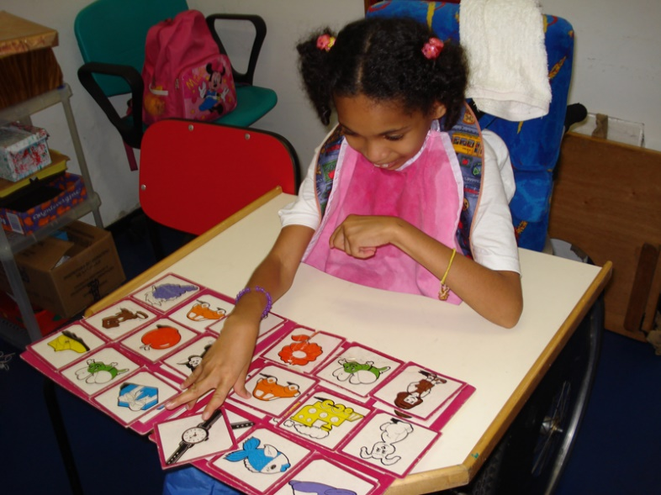
Our Challenge
AHIMSA:
Multiple disabilities, games and play
Notes:
AHIMSA is a school here in São Paulo that works with children that have very serious developmental disabilities. Every day the teachers are faced with an interesting challenge: how can you present information in an engaging way to very young children who are partially or completely blind or deaf? How do you teach a lesson, read a story, or explain an activity to a 4-year-old who doesn’t have the same kind of senses that other children have? Where do you even start?
On the first day of the challenge we worked closely with Inês (ee-ness), an administrator from AHIMSA, to focus on getting as much information as possible. We wanted to know more about the children and how their disabilities affected their interactions with teachers. We wanted to know what sorts of things would evoke a positive response from the children. We also wanted to get a better idea of what kind of environment they’re in, and what sorts of electronic devices are available to them.

Slide 3

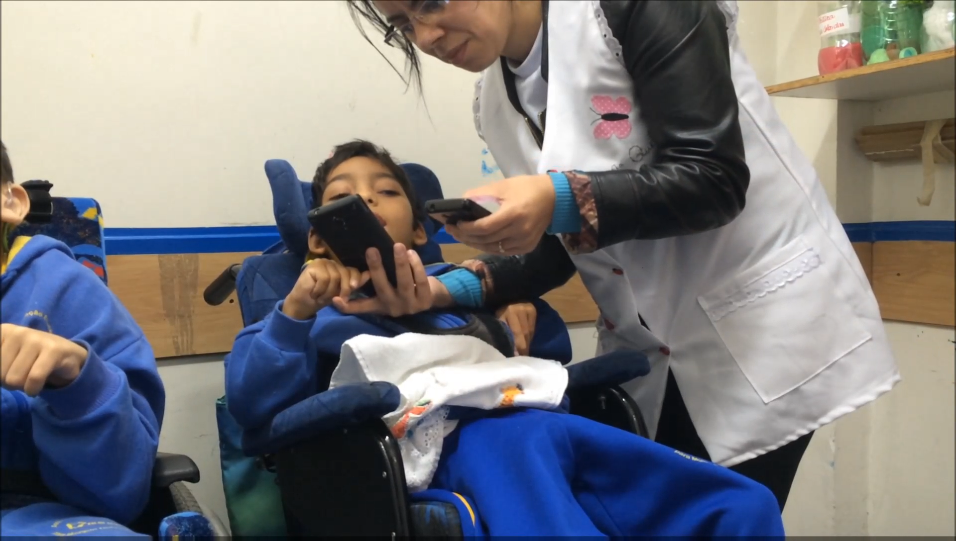
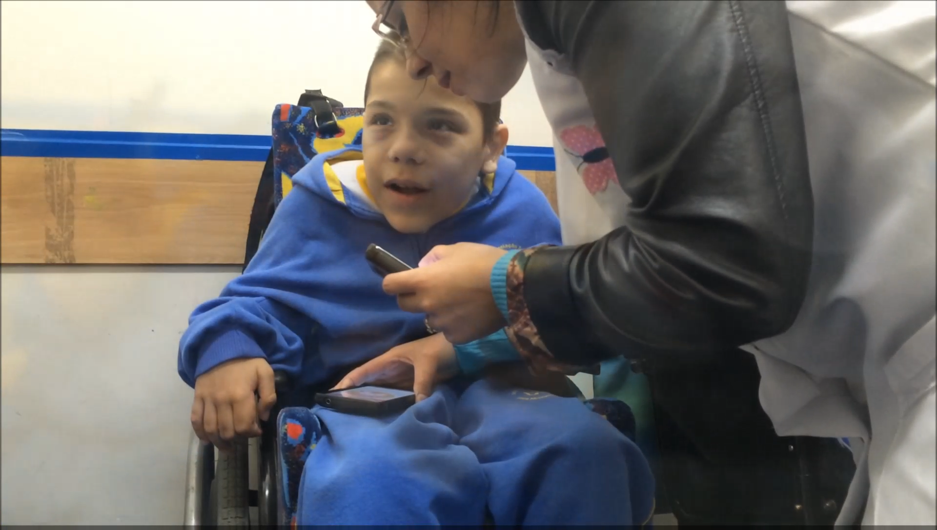
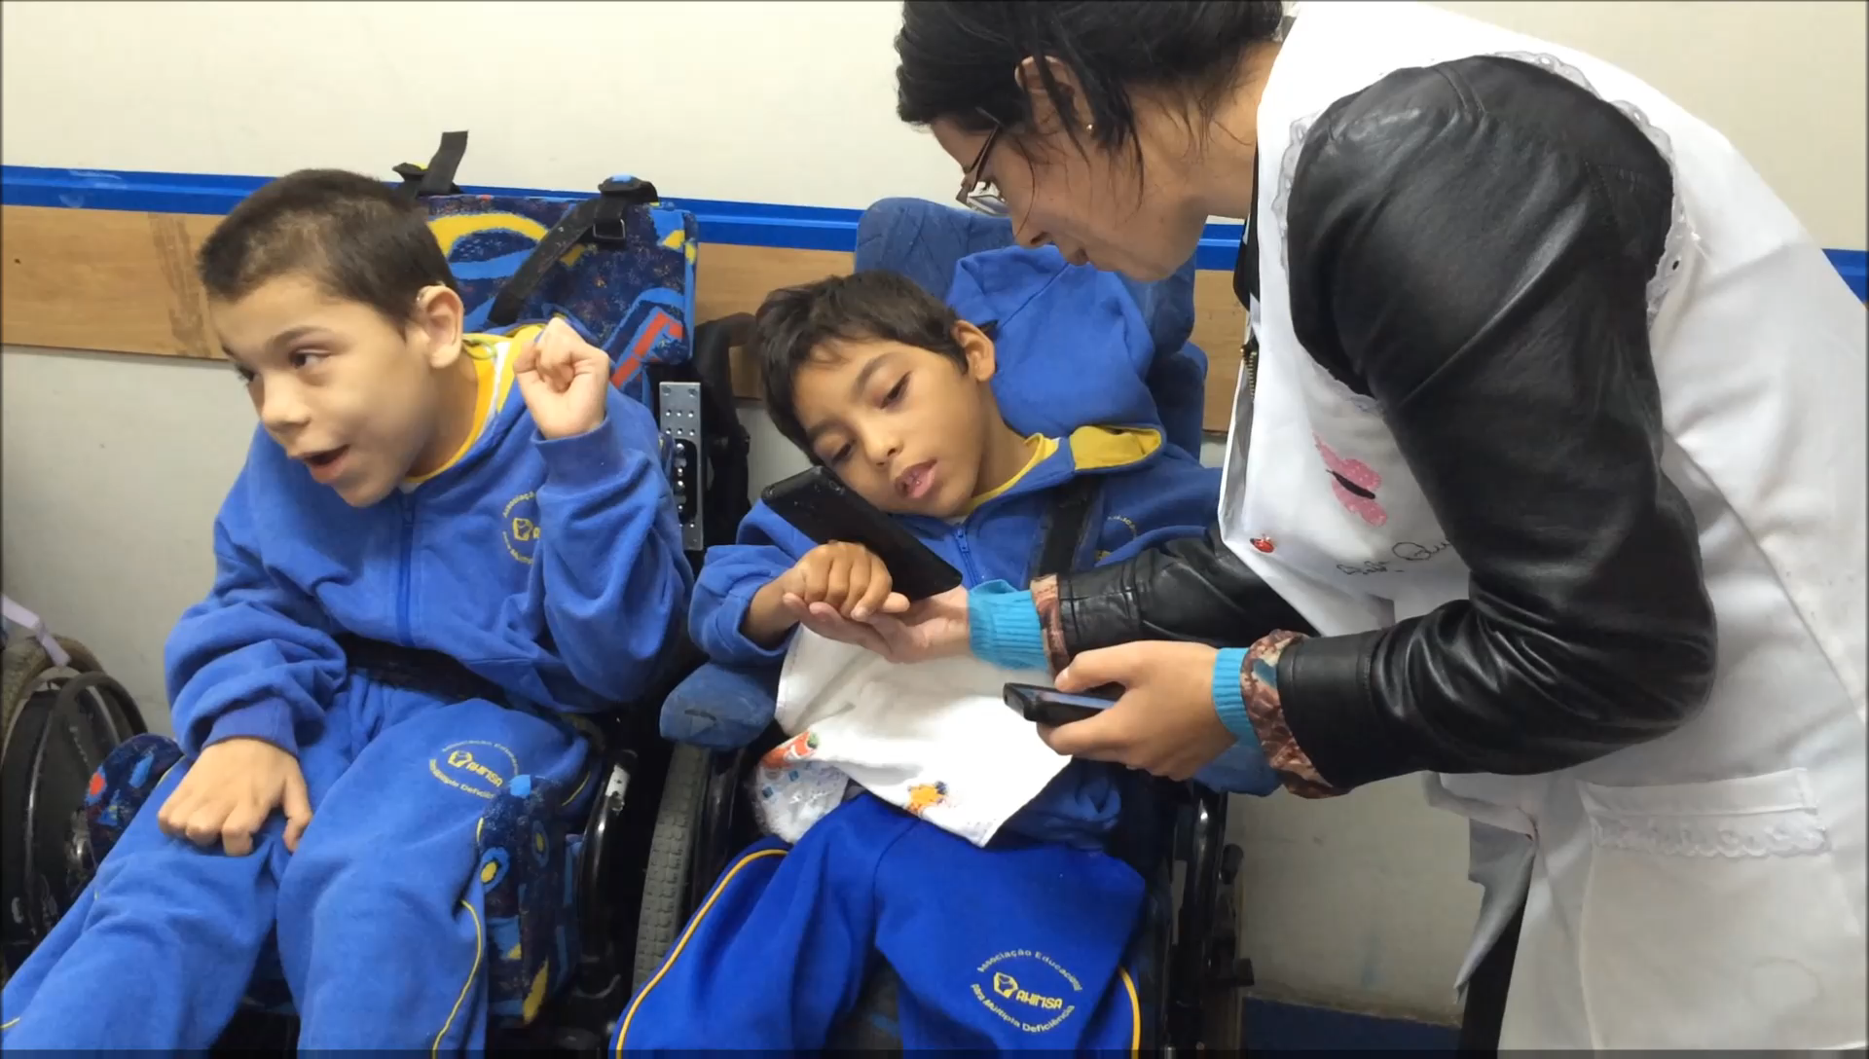
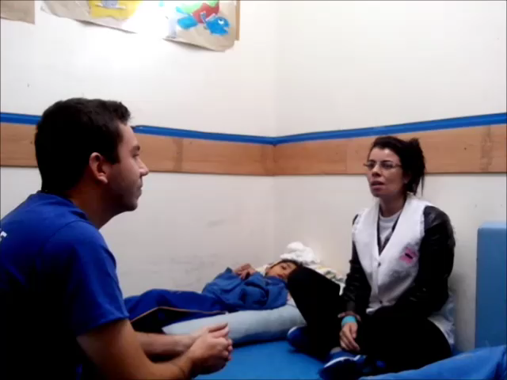
Our Creation
Sentir: a solution that provides a rich sensory experience to children through visuals, sounds, and vibrations.
Notes:
Through a lot of conversations and intense brainstorming sessions, we dreamed up something really exciting. We came up with the idea of giving teachers the ability to control a number of interconnected programmable lights, speakers, projectors, and fans. As they spoke, they would be able to surround the children with sounds and lights and sensations that would help to really engage them. It was a great idea, but it proved to be an expensive endeavour that would have required a lot of extra infrastructure just to get started. There was also a risk that we would acquire all of this extra stuff, only to discover later that perhaps the children wouldn’t even benefit from it.
Rather than completely abandoning this concept, we decided to restructure it into something that could be done using the existing technology at AHIMSA. They own a number of tablet computers, so we realized that we could get started with an application that would let teachers control the images on the screens, the sounds coming through the speakers, and the physical vibrations of the devices.
The name of our app is Sentir, and it means “to feel”. It’s the perfect name for our solution because it gives children a rich sensory experience through visuals, sounds, and vibrations. We’ve put together a prototype of how this could be used by a teacher who would like to read the story “The Three Little Pigs” to students.

Slide 4
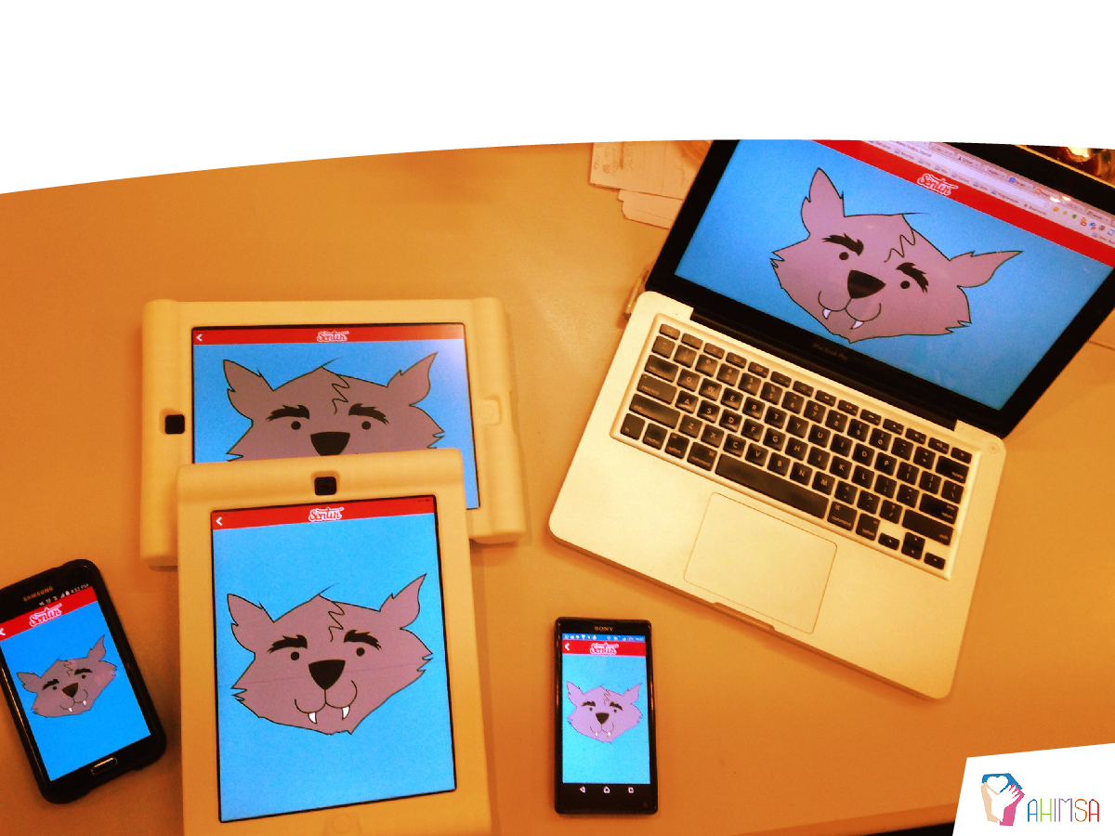
Hands On!
Notes:
[Show devices working.]
With Sentir, no longer are you just reading the story: you are allowing the children to see, to hear, and to feel the story – to the best of their abilities. There are plenty of multimedia streaming apps in the marketplace today, but our innovation is in creating a full sensory experience. Beyond the audio and video, we’ve conceptualized a solution that scales up to provide actual physical sensations.
Now the real question is: how would children respond to it? Rather than trying to guess, we brought our prototype to AHIMSA yesterday morning and had the opportunity to test out our prototype with the actual end users.
We weren’t sure what to expect. The four of us have never worked with children with disabilities. Even though we’d spent a lot of time with our NGO representative, we really had no way of knowing how well our solution would work until it was actually put to the test.
The response? Overwhelmingly positive – take a look!

Slide 5

Notes:
There were smiles and there was laughter: Sentir is a visibly engaging experience.

Slide 6


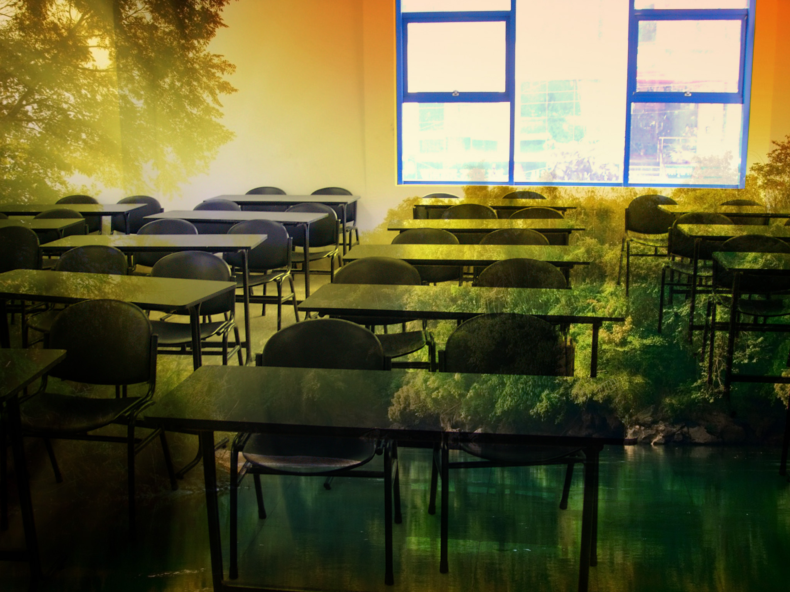
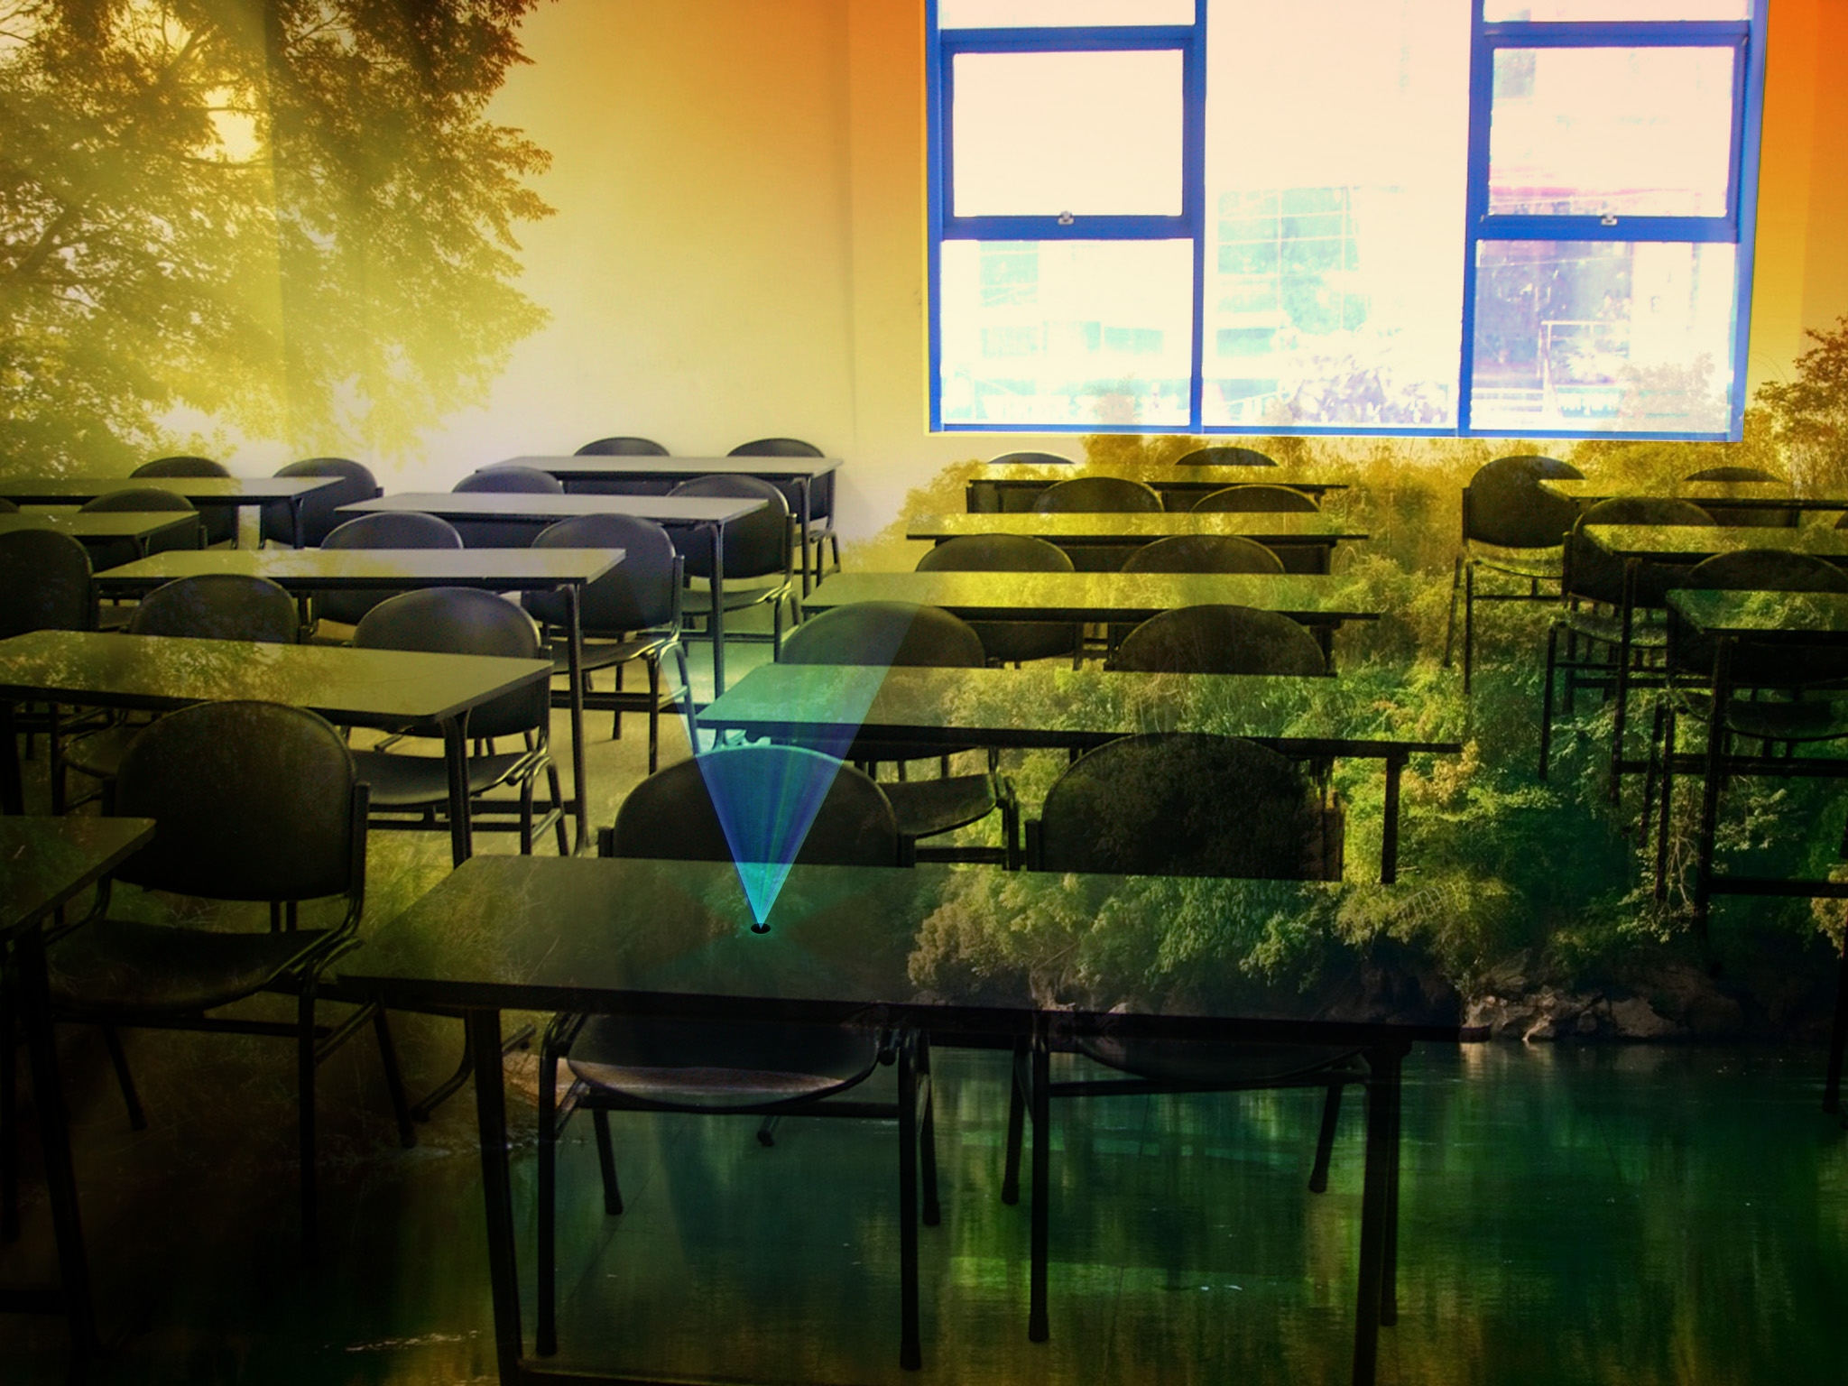
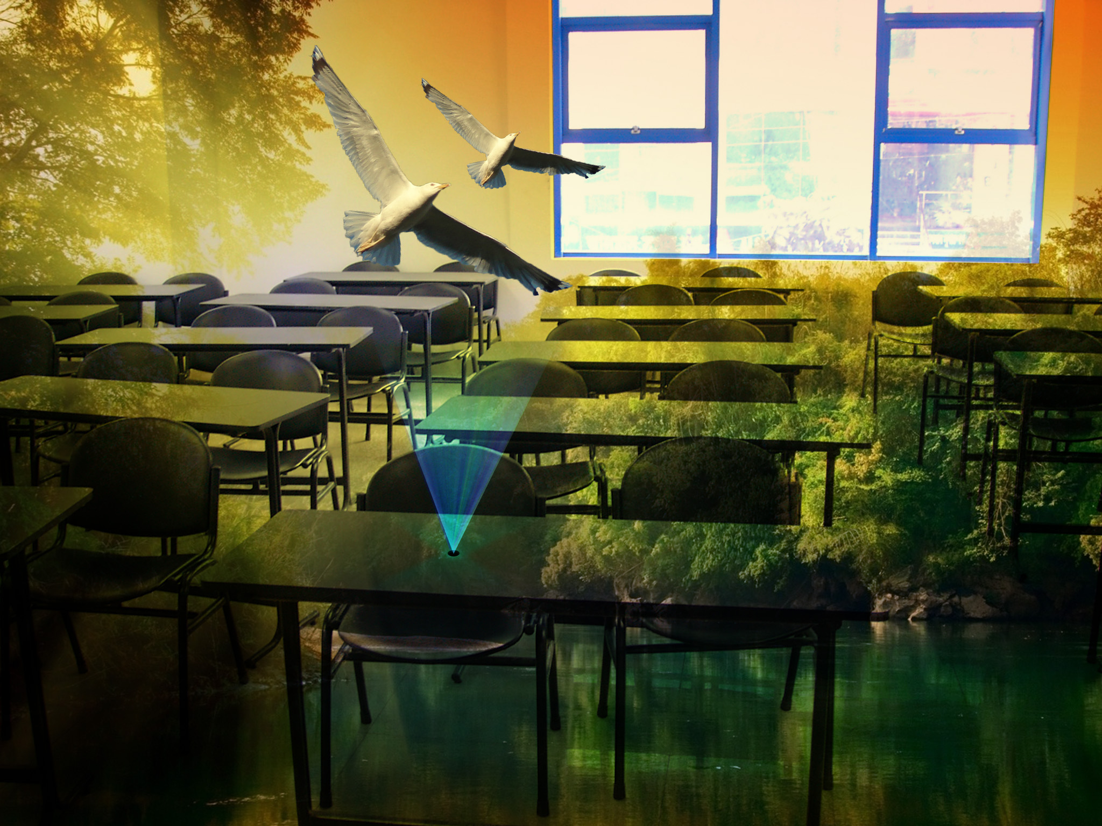

Our Vision
Notes:
So what’s next?
Our solution is so much more than the prototype we have today. Beyond the images, audio, and vibrations from a mobile device, we envision a future where Sentir encompasses the entire room. With programmable coloured light strips, surround sound speaker systems, projector screens, and other devices we can provide a fully immersive experience.
Imagine now that you are talking to a classroom about the forest.
[click] Projectors can cover the walls with images of the trees. A yellow light can shine from a corner of the room, giving the impression of sunlight.
[click] The sound of chirping can come from their hands and from the speakers around them.
[click] Birds can appear on the screens of the devices that the children can see and touch.
[click] A fan could blow air across the room to simulate a gentle breeze. The scene can change at the touch of a button, adapting to the teacher’s message and keeping the children engaged.

Slide 7

Our Vision
More interactive features
Collect feedback from children
Share using the cloud
Notes:
We also see opportunities for even more interactive features. Teachers can ask children questions that can be answered by touching the screen or shaking the device. New collections can be created as games or group activities. We could collect feedback from the devices to give us a better idea of how the application is helping.
Setting up the server on the cloud would allow for the app to be used by any teacher or parent in the world. New collections could be created by anyone and uploaded to share with other users. Just imagine a whole library of lessons, games, books, and presentations!
There are 82 children at AHIMSA that would benefit from using Sentir, but just think about the thousands of others across Brazil, South America, and around the world. And not only children with disabilities – every child can enjoy this experience. We put this theory to the test with Rodrigo’s children, who had a lot of fun experiencing the story that we created. Our solution allows teachers to communicate with children of all abilities, bringing them together and giving them an equal opportunity to understand a message, to enjoy a story, to learn about a topic.

Slide 8
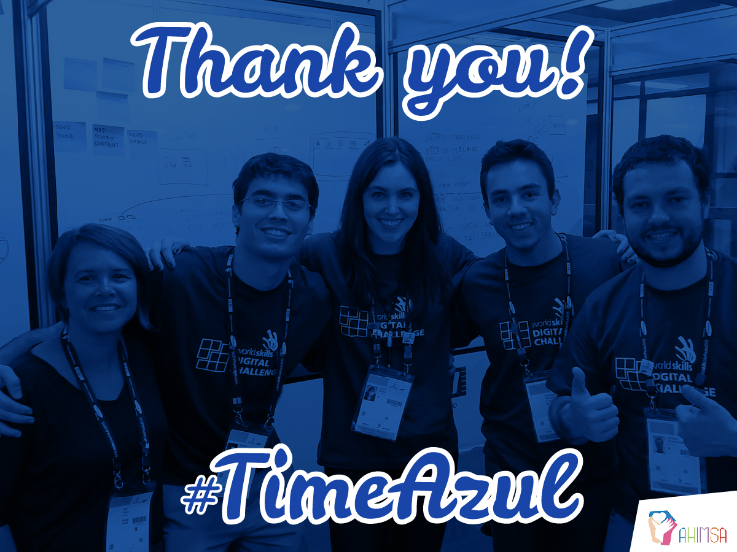
Notes:
This week has been an incredible experience for all of us and we’re excited about the opportunity for our solution to make a difference for children. Thank you to the organizers, the mentors, the other participants, and the NGOs for all of your help and guidance!

Slide 9
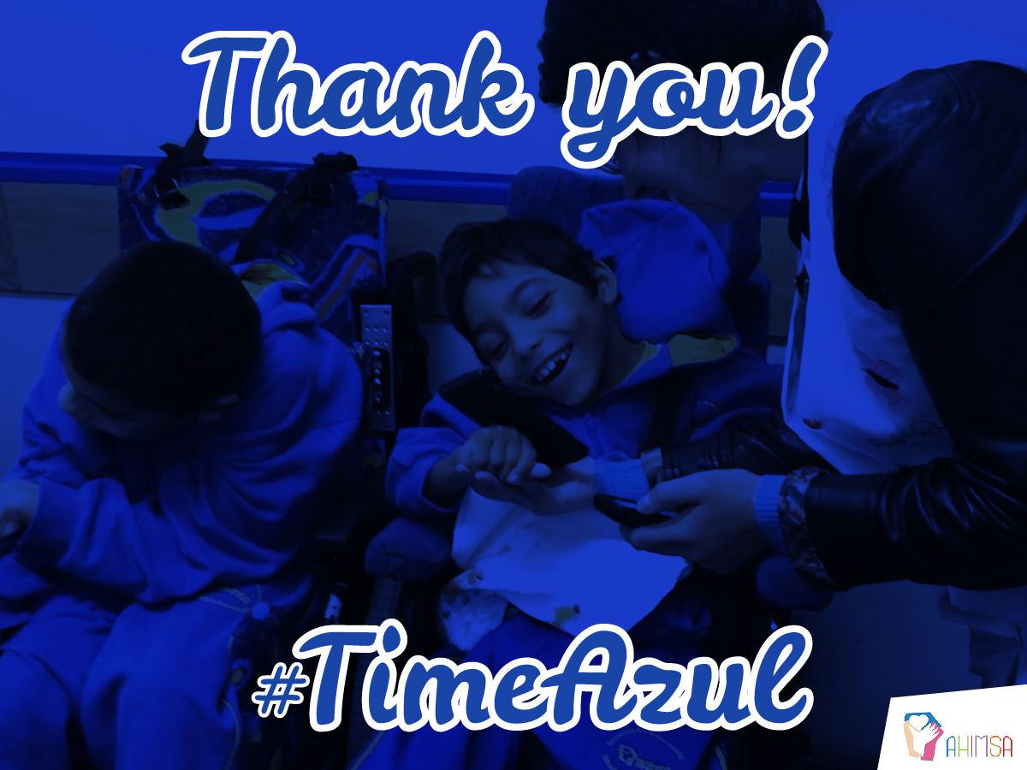
Notes:
Every child deserves this feeling. With Sentir.

